Slide 1
Ensuring Credibility of Online User Reviews
Bipasha Banerjee
Smridh Malhotra
Ramya Nandigam

Slide 2



Introduction
Online forums are getting increasingly affected by deceptive user reviews
Current methods
Place more emphasis on detecting non-credible reviews than on detecting non-credible users
Classify a review as either credible or deceptive
Give more credibility to long-term users

Slide 3
Proposed Approach
Implemented algorithms laid out in NETINF¹ and EigenTrust² papers
Two major steps:
Estimate structure of user-user network based on review timestamp and usefulness score of review given in the dataset
Assign global trust value to each node (aka user) in the network

Slide 4
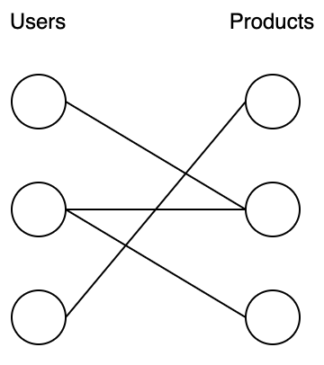
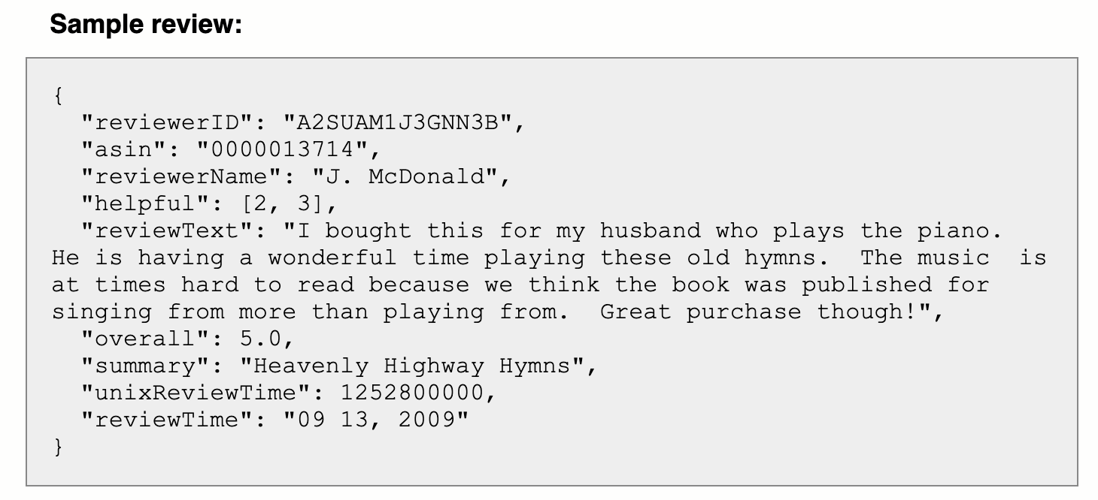
Dataset Used
Amazon Musical Instruments reviews SNAP dataset
2.5 MB of data (~10,000 reviews)
Includes reviewer ID, product ID, usefulness score of review, Unix timestamp of review

Slide 5
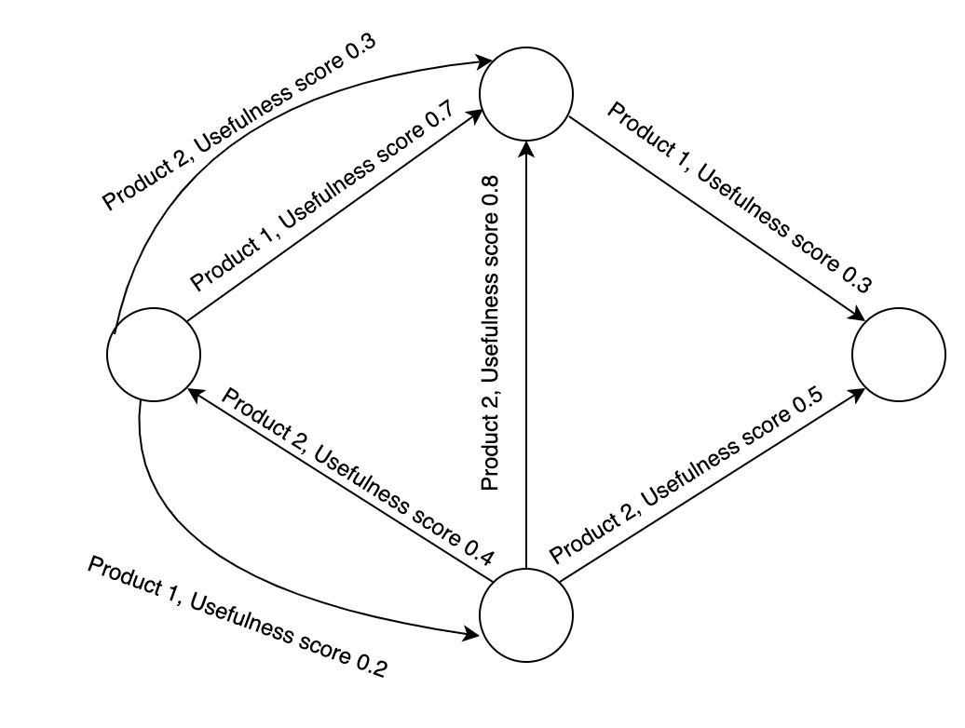
NETINF + EigenTrust

Slide 6
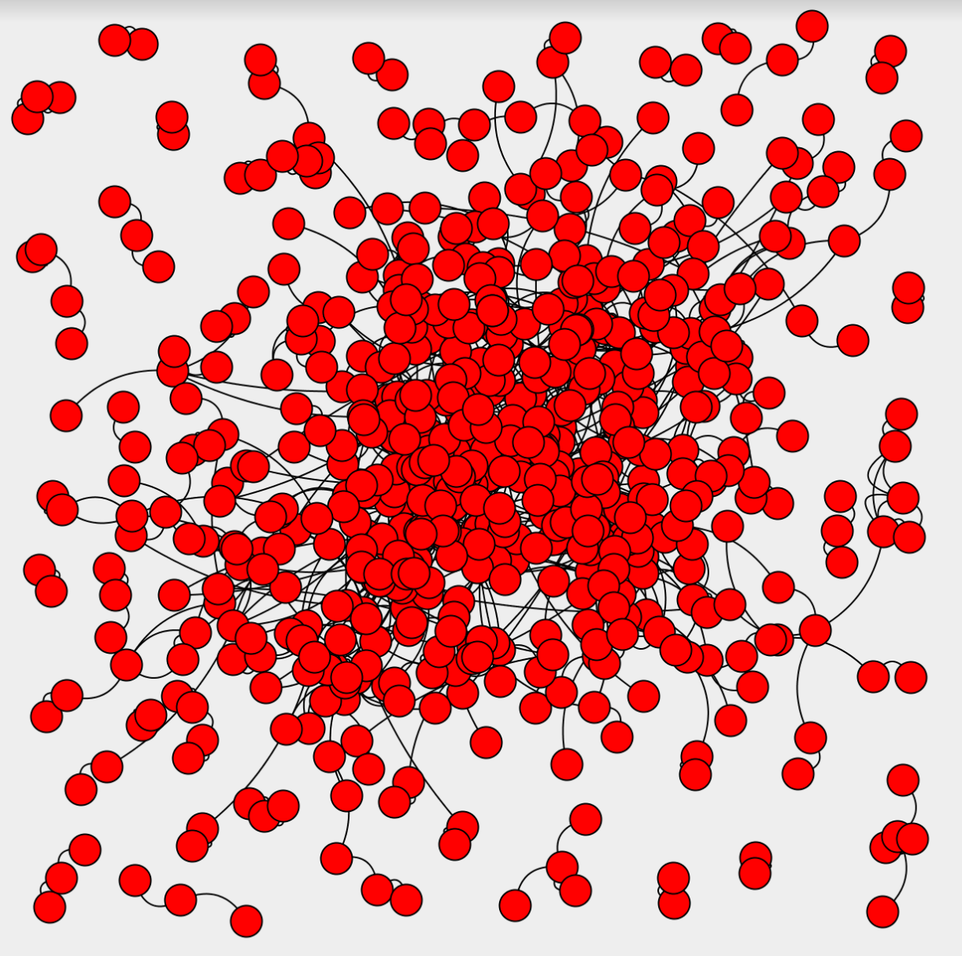
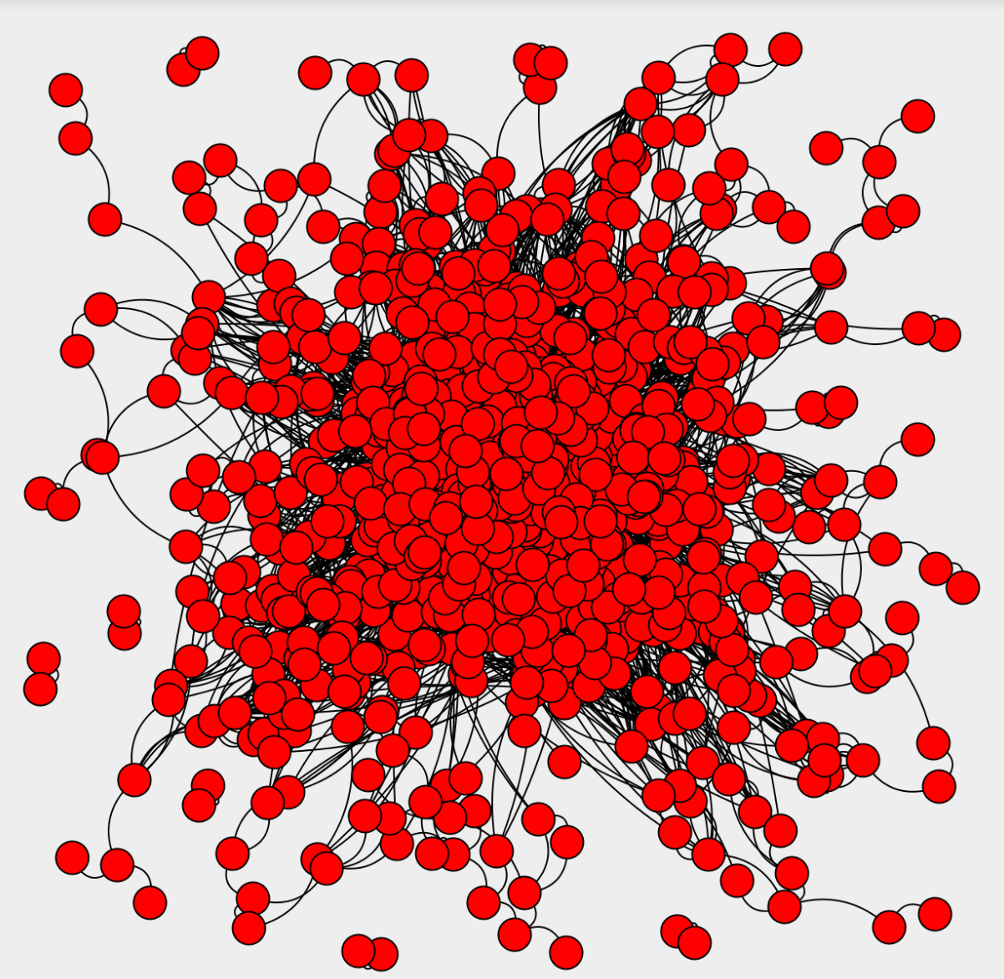
Results

Slide 7
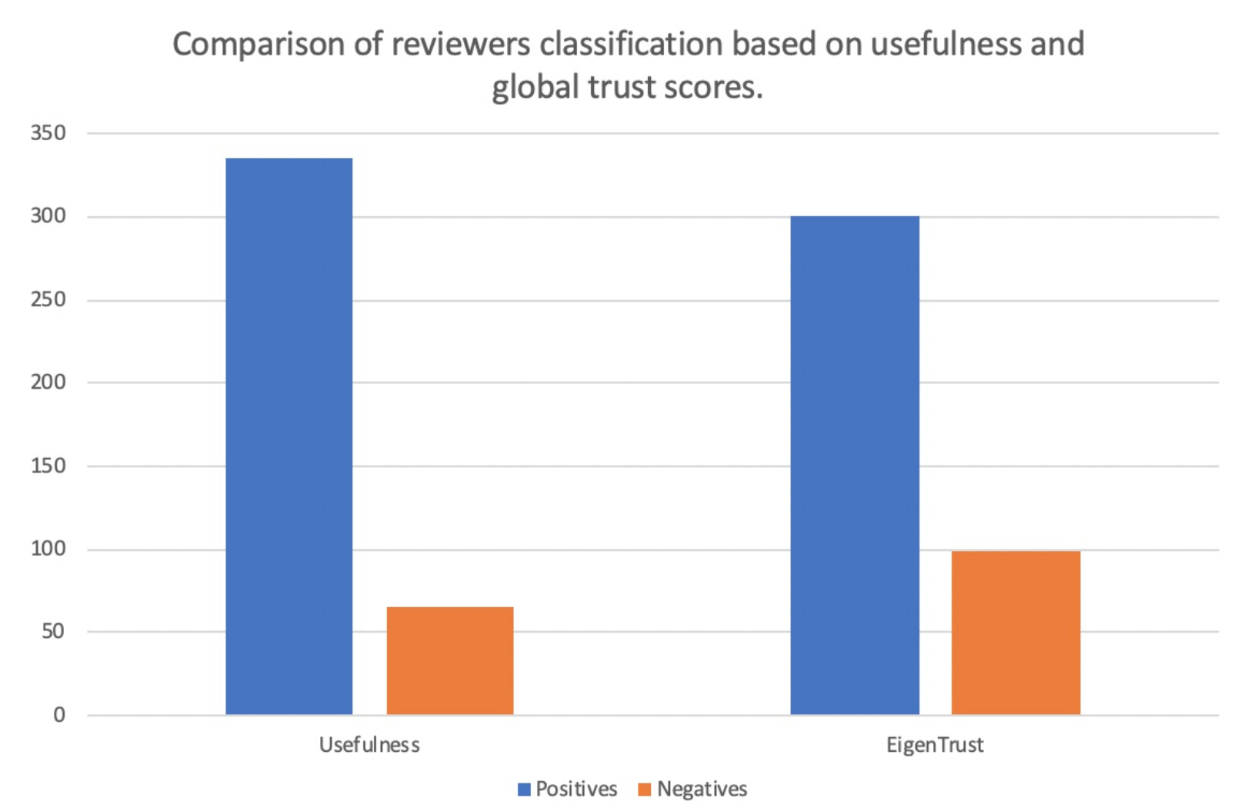
Evaluation
With usefulness scores:
335 credible reviews
65 non-credible reviews
With global trust based calculations:
301 credible reviews
99 non-credible reviews

Slide 8
Conclusion & Future Work
Implementation of NetInf and EigenTrust algorithms allowed us to obtain user-user relations and global trust scores
Future work:
Generalize approach to fit other trust-based models
Determine other parameters which can be used to build a more well-rounded user-user network

Slide 9
Bibliography
[1] M. Gomez-Rodriguez, J. Leskovec, and A. Krause. Inferring Networks of Diffusion and Influence. ACM Trans. Knowl. Discov. Data, 2012.
[2] S. Kamvar, M. Schlosser, and H. Garcia-Molina. The Eigentrust Algorithm for Reputation Management in P2P Networks. Proceedings of the 12th International Conference on World Wide Web, 2003.

